Slide 1
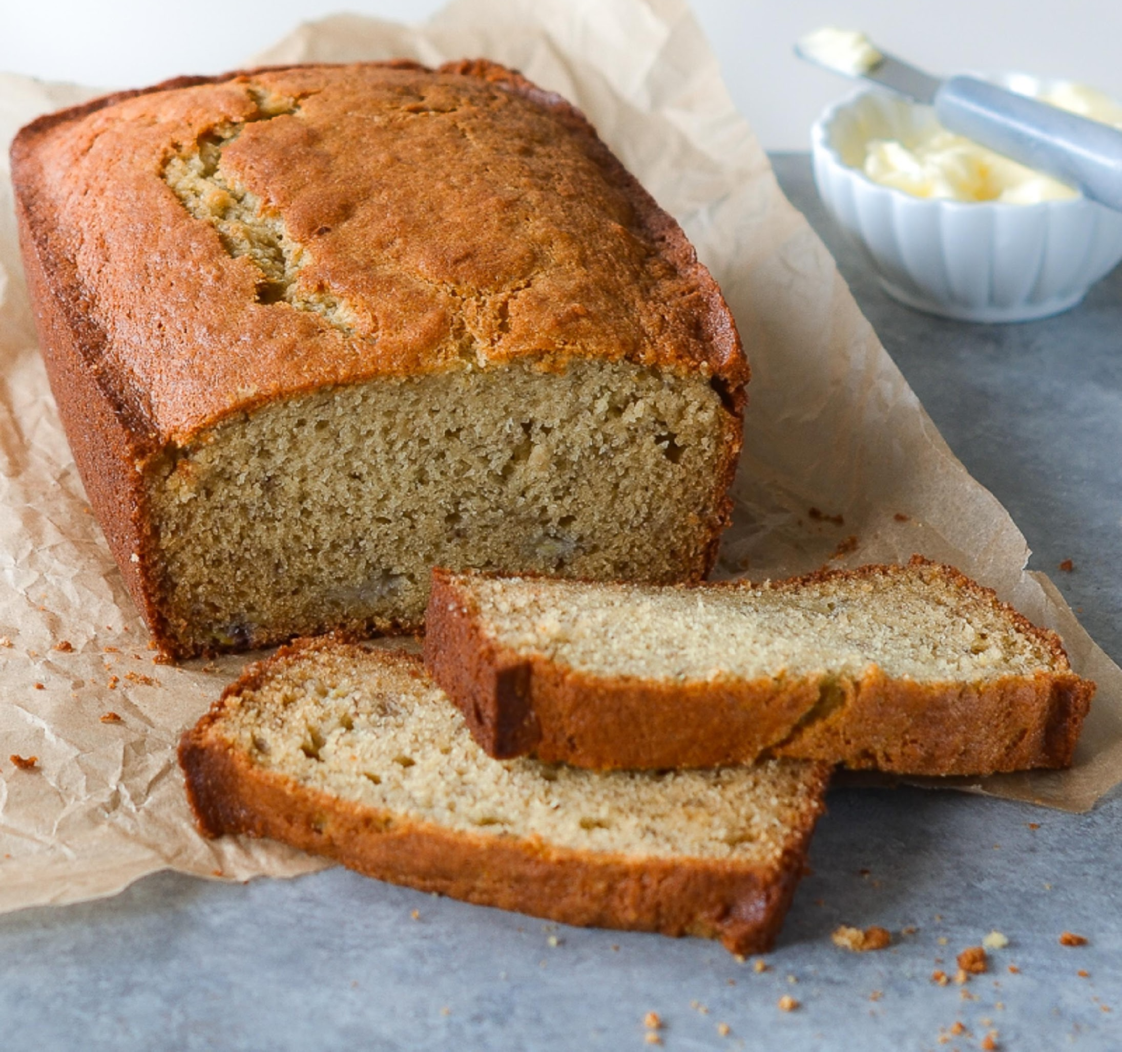
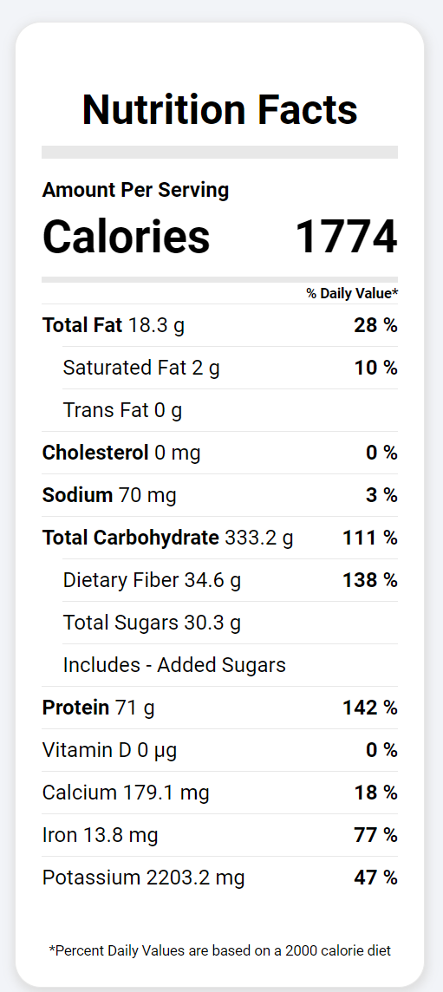
EAT EASIER
Recipes Finder + Nutrition Analysis
Projected and Designed by Adriano Crippa and Diana Majolli

Slide 2
Web Services - Project
Team Members:
Adriano Crippa Elicker
Diana Majolli
Database:
Edaman™ - https://www.edamam.com/terms/api/

Slide 3
Description
EAT EASIER is web project designed to help people explore, create, and enjoy their meals. This comprehensive platform seamlessly integrates recipe discovery and nutrition analysis, empowering users to make informed dietary choices while satisfying their taste buds.

Slide 4
Description (continuation)
Recipe Finder: Discover a vast collection of recipes spanning various cuisines, dietary preferences, and meal types. Search by ingredients ensuring a personalized culinary experience.
Nutrition Analysis: Gain insight into the nutritional content of each recipe, including calories count, macronutrients (carbohydrates, proteins, fats), vitamins, and minerals. Set dietary goals and track your daily intake, promoting healthier eating habits.

Slide 5
With a database with close to 900,000 foods, Edamam provides free Food API access with its basic plan for developers, startups and non-profits alike. Edamam's API have been relatively friendly to integrate into our project, saving time and effort during development and offering features and capabilities that align closely with the requirements of the project.
About Edamam

Slide 6
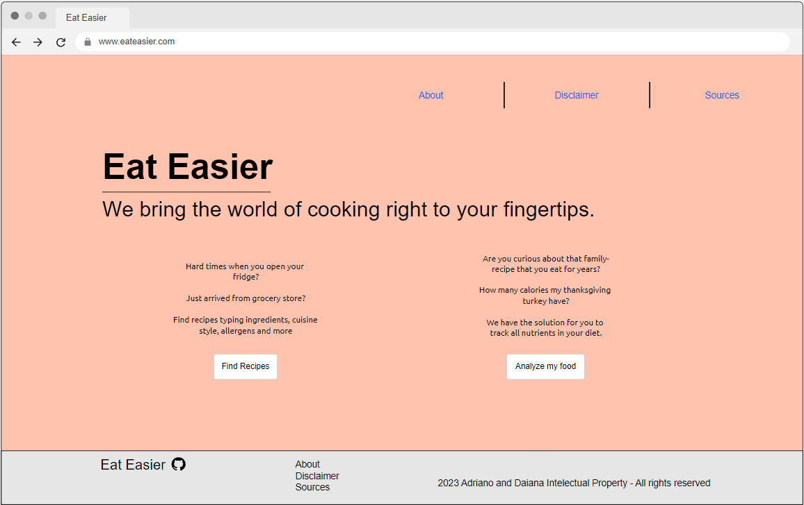
Mock-up design
Index page

Slide 7
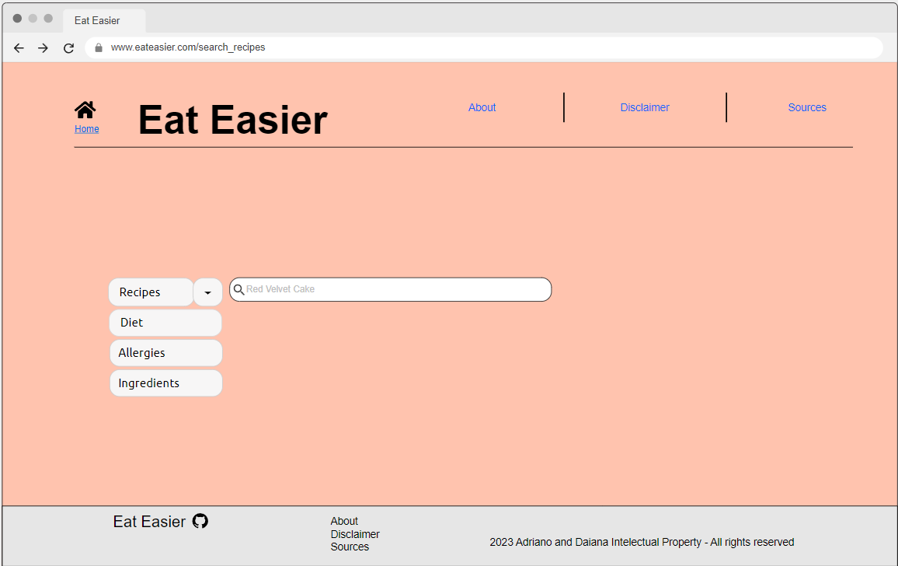
Mock-up design
Search recipes

Slide 8
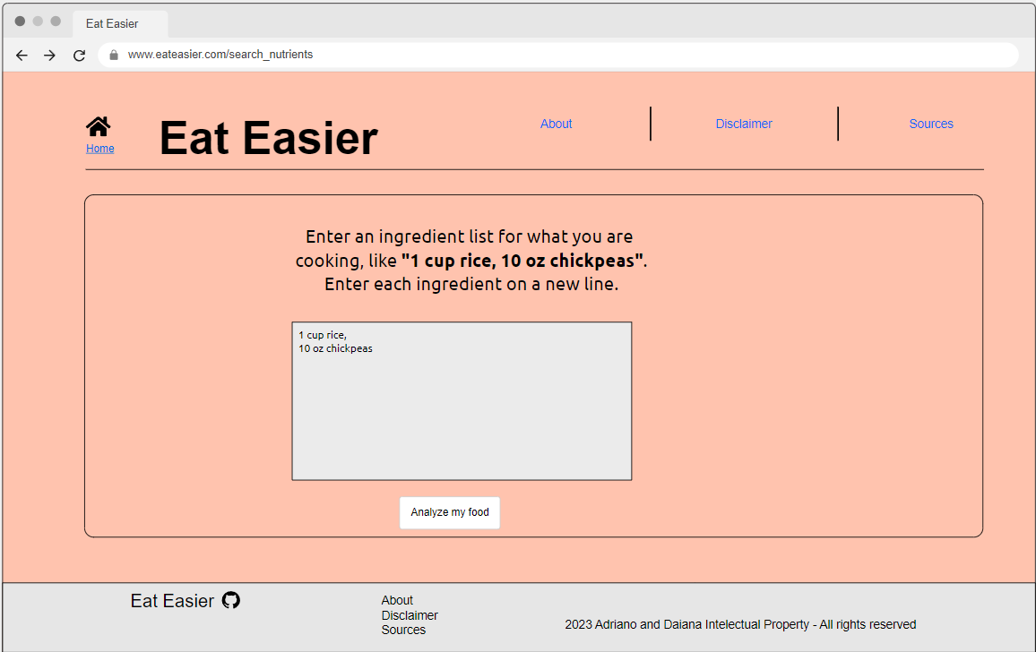
Mock-up design
Search nutrients

Slide 9
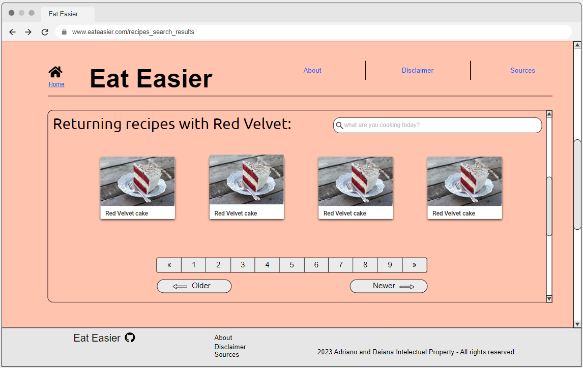
Mock-up design
Recipes results

Slide 10
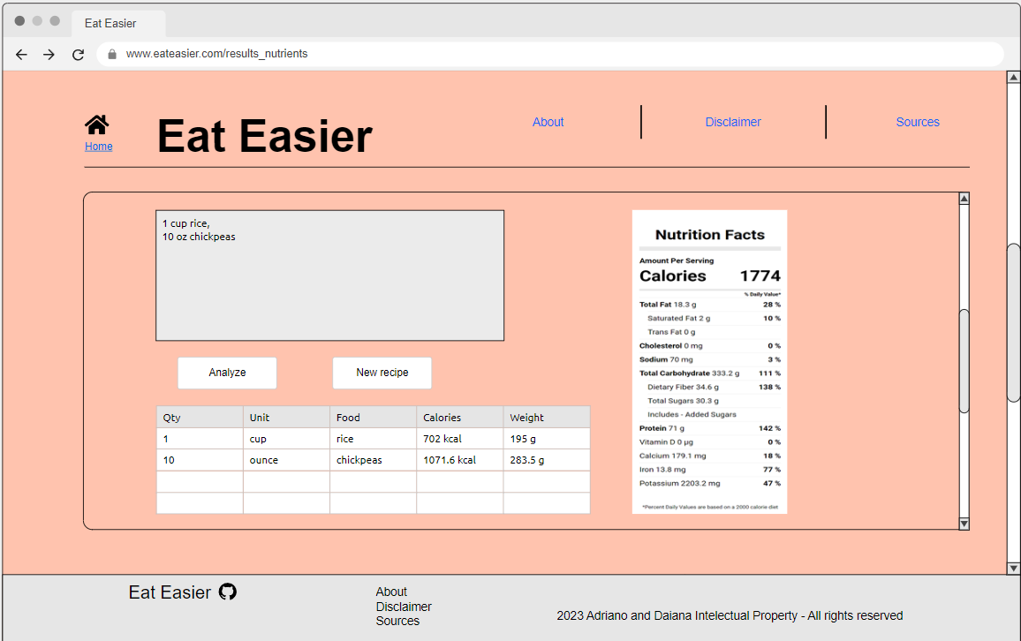
Mock-up design
Nutritional results

